Slide 1
Digital Portfolio
STUDENT NAME: M.Sanjai
REGISTER NO AND NMID: asunm185202414010
DEPARTMENT: B.Sc.Computer Science
COLLEGE:ANNAI THERASA ART’S AND SCIENCE COLLEGE

Slide 2
Digital Portfolio Webpage

Slide 3


AGENDA
Problem Statement
Project Overview
End Users
Tools and Technologies
Portfolio design and Layout
Features and Functionality
Results and Screenshots
Conclusion
Github Link
3/21/2024 Annual Review

Slide 4

PROBLEM STATEMENT
In today’s digital world, students and professionals need a platform to showcase their skills and achievements effectively.
Traditional resumes are static and fail to represent creativity, coding skills, or real-time project updates.
Lack of interactive and structured portfolios limits opportunities for recognition and career growth.
Need for a digital portfolio system that is dynamic, user-friendly, and customizable.

Slide 5

PROJECT OVERVIEW
Designed to improve visibility during placements, internships, and competitions.
Supports interactive UI, real-time updates, and integration with GitHub/LinkedIn.
The project is a Digital Portfolio Platform that allows students to create, manage, and share their professional achievements.
It provides a centralized platform to display skills, projects, certifications, and academic details.

Slide 6

WHO ARE THE END USERS?
Students – showcase skills, certifications, and projects.
Recruiters / HR Professionals – evaluate candidate profiles efficiently.
Faculty / Mentors – track student achievements and project progress.
Startups / Companies – identify and recruit talent.

Slide 7

TOOLS AND TECHNIQUES
Frontend: HTML5, CSS, JavaScrip
Backend: Python / Node.js
Version Control: Git, GitHub
Design Tools: Visual Studio code
Hosting:GitHub Pages / AWS

Slide 8
POTFOLIO DESIGN AND LAYOUT
Home Page – Student introduction and highlights.
About Page – Bio, academic background, and career goals.
Projects Page – Showcase with images, descriptions, and GitHub links.
Skills Page – Technical and soft skills with progress bars/icons.
Certificates / Achievements Page – Uploaded proofs and awards.
Contact Page – Email, LinkedIn, and social media links.
Responsive design for both desktop and mobile view.
8

Slide 9
FEATURES AND FUNCTIONALITY
User authentication (Login/Signup).
Add, edit, and delete project entries.
Upload certificates and achievements.
Integration with GitHub for auto project updates.
Search and filter functionality.
Easy-to-navigate UI with modern design.

Slide 10

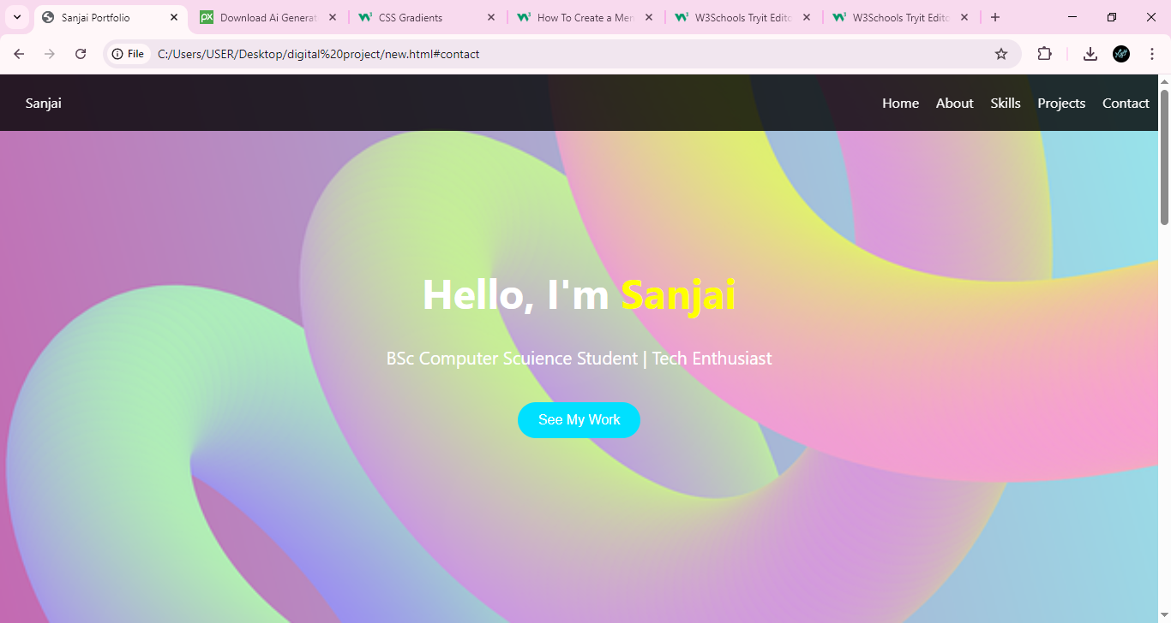

RESULTS AND SCREENSHOTS
This is the screenshort of the final project
3/21/2024 Annual Review
10

Slide 11
CONCLUSION
Developed a functional and user-friendly digital portfolio platform.
Solves the gap between traditional resumes and modern digital requirements.
Benefits both students and recruiters by enhancing professional visibility.
Future Scope:
AI-based skill recommendations.
Resume PDF auto-generation.
Collaboration tools for team projects.
11

